Slide 1

Enny’s Superstore analysis project
By group 1:
Edidiong udoh
Nwabuwa
Mark Osagie
Moyo
Hannah

Slide 2
EXECUTIVE SUMMARY
PROBLEM STATEMENT DEFINITION
The Dataset chose for this project is an e-commerce dataset. The Problem Statement is “How to Increase Business Revenue of Enny’s Super Stores”.
THE SCENARIO
Enny’s Super Stores operating within the US has given us (GROUP 1) the task to identify what works best for them in terms of sales and making profit. Using exploratory data analysis (EDA) we will help them identify:
Their most and least profitable product categories (“Technology” and “Furniture” product respectively)
Segment analysis of sales and profit (“Consumer” segment generated highest Profit and Revenue)
Geographical analysis of sales and profit (State “California” and Region “West” generated highest Profit)
Given the insights gained from the EDA, the superstore can choose to remove non-profitable products or invest in marketing efforts for products, segments and geographical areas that are driving their profit

Slide 3
Data-Set Description
The data-set used for this project is an e-commerce data set of sales and shipping transactions between 2014 and 2017, The data set for this project was obtained online from kaggle. It contains information such as Order Id, Order Date, Shipping date, Shipping mode, Customer name, Region, States, Sales, Quantity, Profit, etc.
The data from this particular store spans over 1457 days with sales totaling at $2,297,201 and a profit of $286,397. There are 1862 unique articles in their inventory which are divided into 3 categories, all of which are being sold across 49 states in the US.

Slide 4
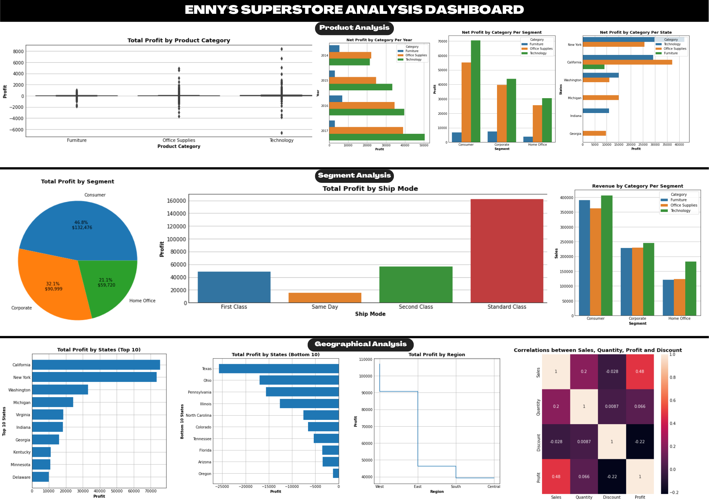

Slide 5
Summary/Recommendation
Summary of Insights
Product Analysis
Generally, Category “Technology” generated highest revenue and net profit across the different segments, shipping mode and year (except for 2014). “Technology” sold more in “California”, but it generated more profit only in “New York”; while “California” generated highest profit with “Office Supplies” product.
Segment Analysis
Segment “Consumer” contributed highest net profit over 46%, and “Home office” contributed the least at 21%.
Geographical Analysis
State “California” generated highest net profit, while “Texas” generated highest net loss. Region “West” generated highest net profit.
Recommendation
Given the insights gained from the EDA, the superstore can choose to remove non-profitable products or invest in marketing efforts for products, segments and geographical areas that are driving their profit.

